Slide 1

Sales Overview
Performance Over the Period

Slide 2
Agenda
Key Performance Metrics
Regional Sales Performance
Product Category Analysis
Online vs. Offline Sales Performance
Salespersons Performance
Key Insights

Slide 3
Key Performance Indicators
2001 July to 2004 June
$140.60M
30.44K
$4.62K
52K
Total Sales
Number of Orders
Average Order Value
Quantity of Sales

Slide 4
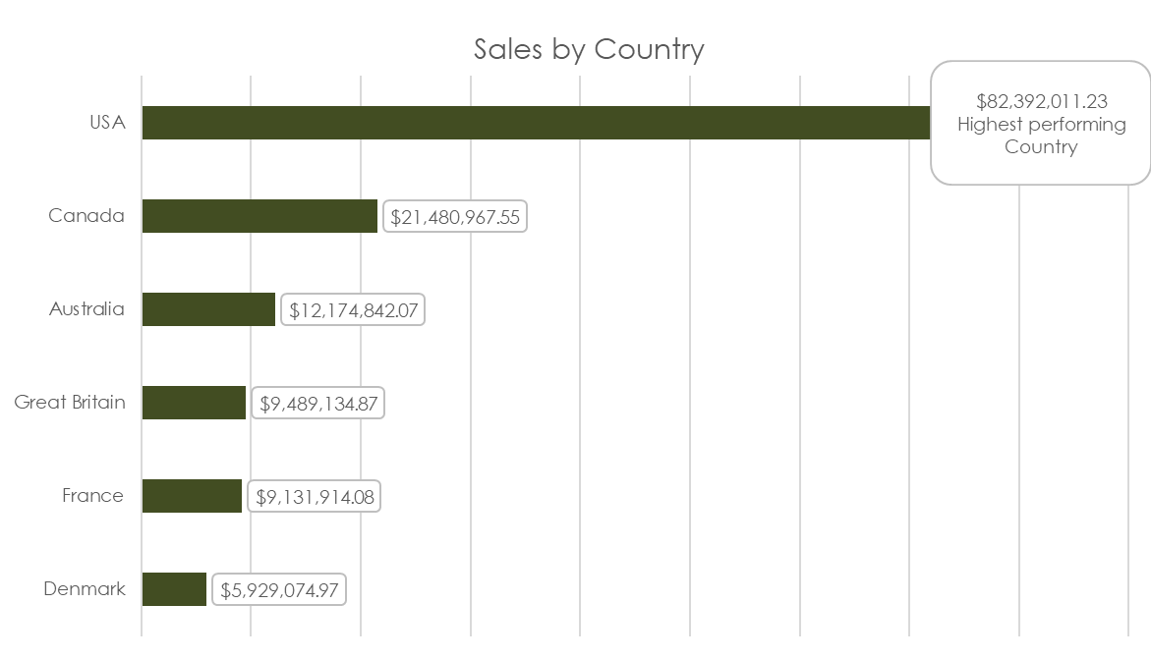
Regional Sales Performance
Key Insights
The United States (59% of the total sales) is the top-performing country in sales, while Denmark ( 4% of the total sales) ranks as the lowest.
This highlights a considerable variation in sales performance across regions.

Slide 5
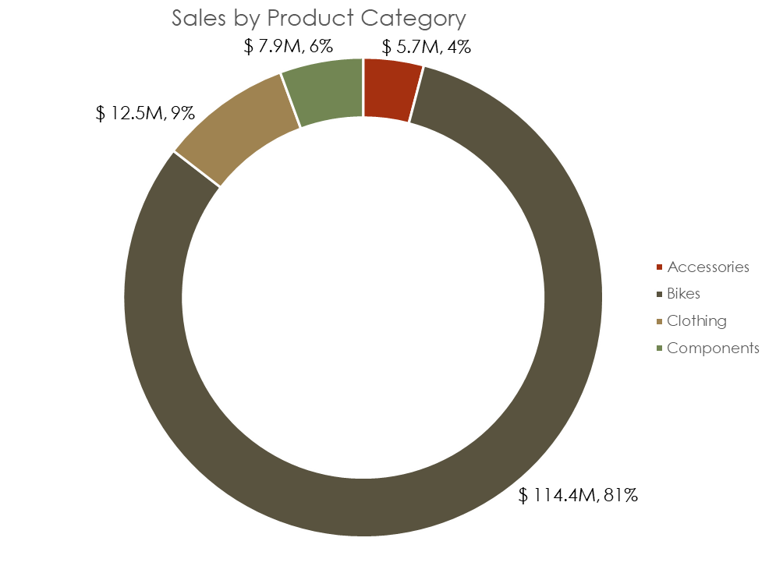
Product Category Analysis
Key Insights
Bikes lead as the top product category, contributing 81% to total sales.
In contrast, Accessories are the least performing category, accounting for only 4% of sales.

Slide 6
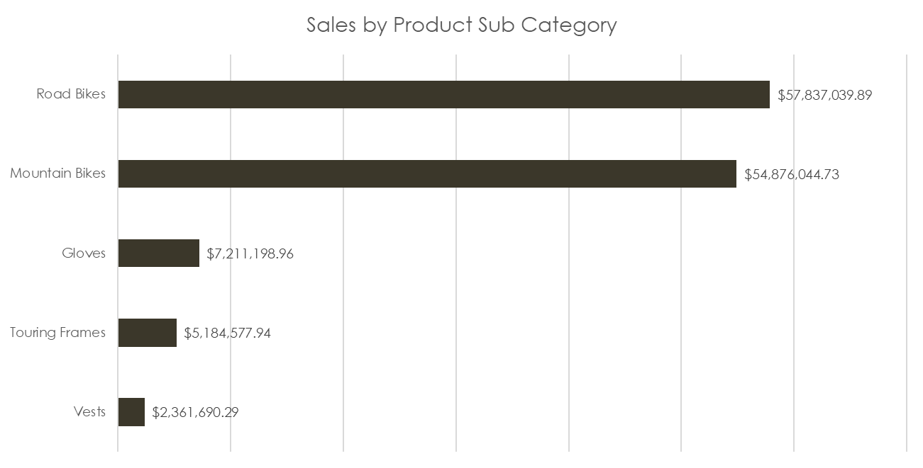
Product Sub-Category Analysis
Key Insights
Road Bikes dominate the sales among subcategories, accounting for 41% of total sales
Mountain Bikes also perform strongly, contributing 39%, highlighting the popularity of both bike types in driving overall sales.

Slide 7
Online Sales Performance
2001 July to 2004 June
$32.33M
26.63K
$1.21K
27K
Online Sales
Number of Orders
Average Online Sales
Quantity | Online Sales
Notes:
As we are steering the company toward, the executives should clearly understand how the company performing.

Slide 8
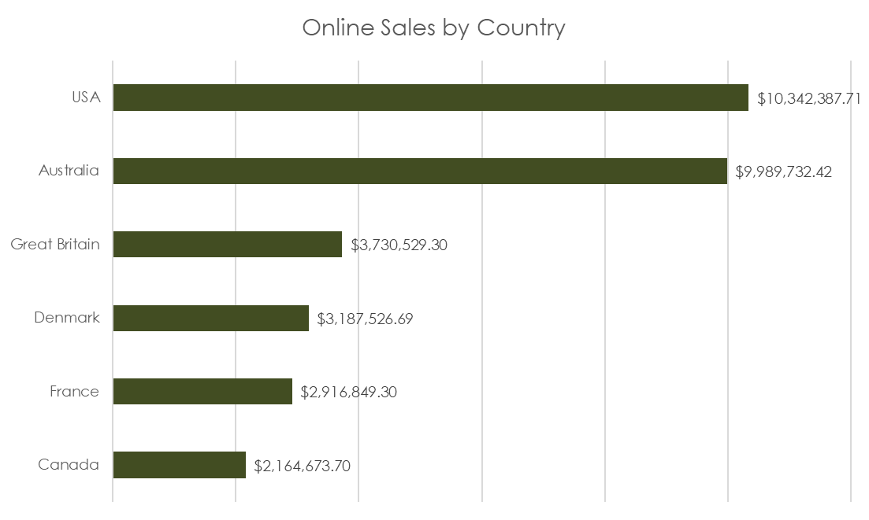
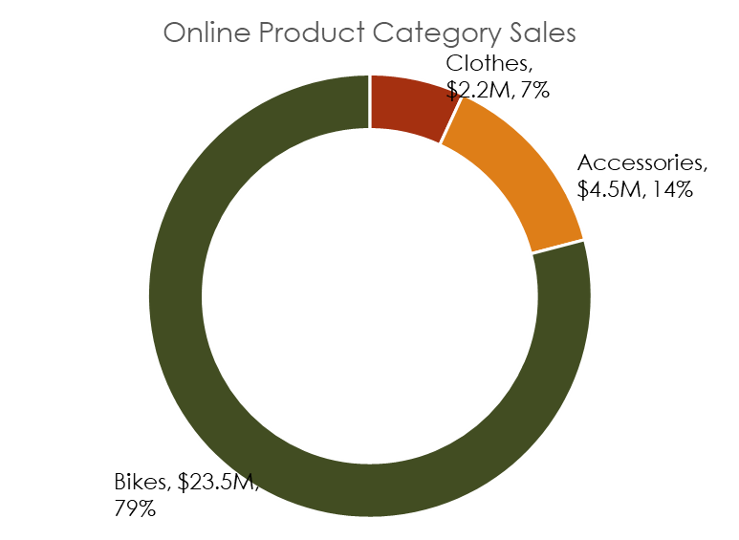
Online Product Category Analysis
Key Insights
The United States leads in online sales, reaching an impressive total of $10 million.
Bikes are the top-selling product in this segment, making up 79% of all online sales, underscoring their strong dominance in the market.

Slide 9
Offline Sales Performance
2001 July to 2004 June
$108.27M
3.81K
$28.45K
25K
Offline Sales
Number of Orders
Average Offline Sales
Quantity | Offline Sales
Notes:
As we are steering the company toward, the executives should clearly understand how the company performing.

Slide 10
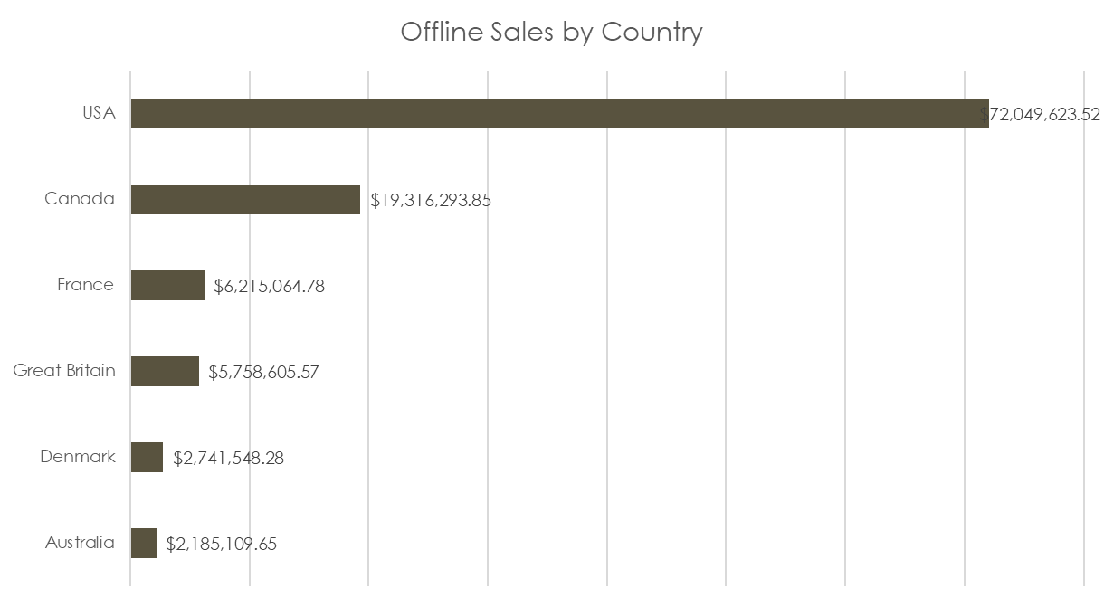
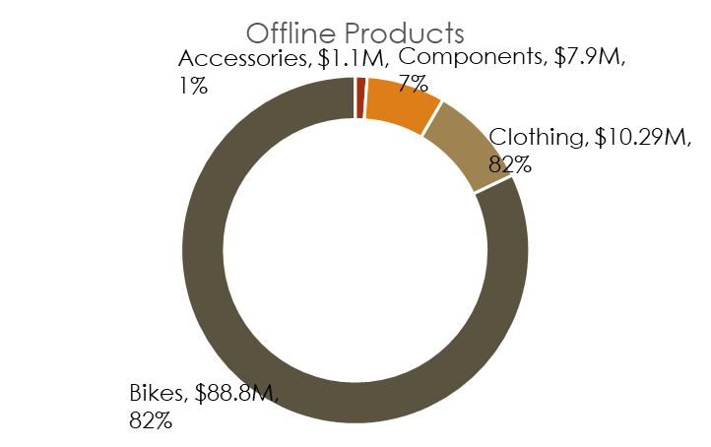
Offline Product Category Analysis
Key Insights
The United States stands out as the best-performing region in offline sales, generating $72 millionn
Bikes is the best performing product offline.

Slide 11
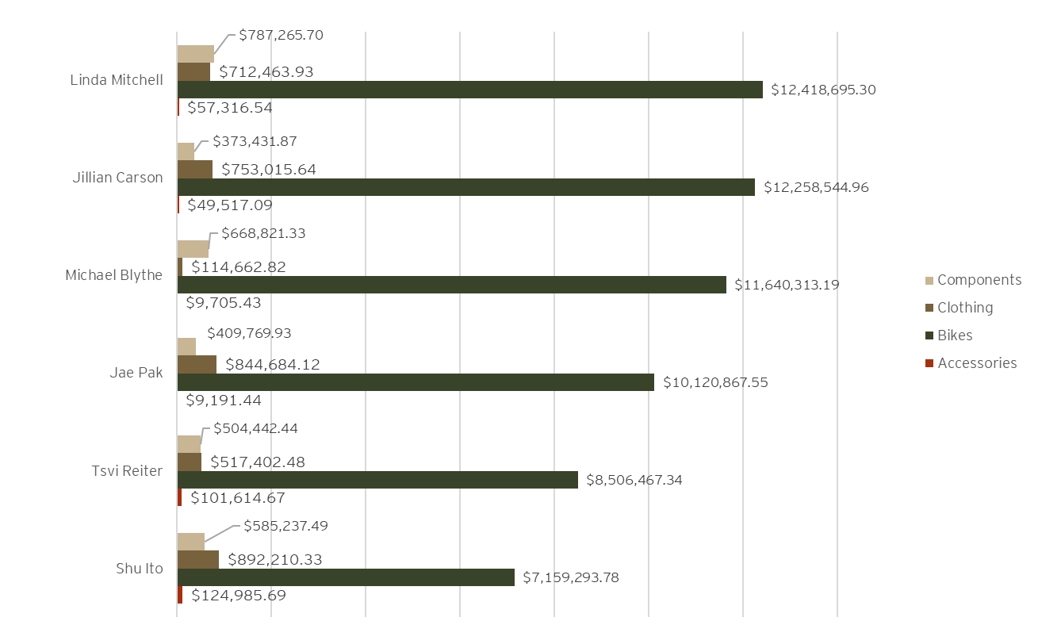
Salespersons Performance
Key Insights
Sales By Sales Person
Linda is the top-performing salesperson, achieving approximately $14 million in sales, underscoring her exceptional contribution to overall revenue.

Slide 12
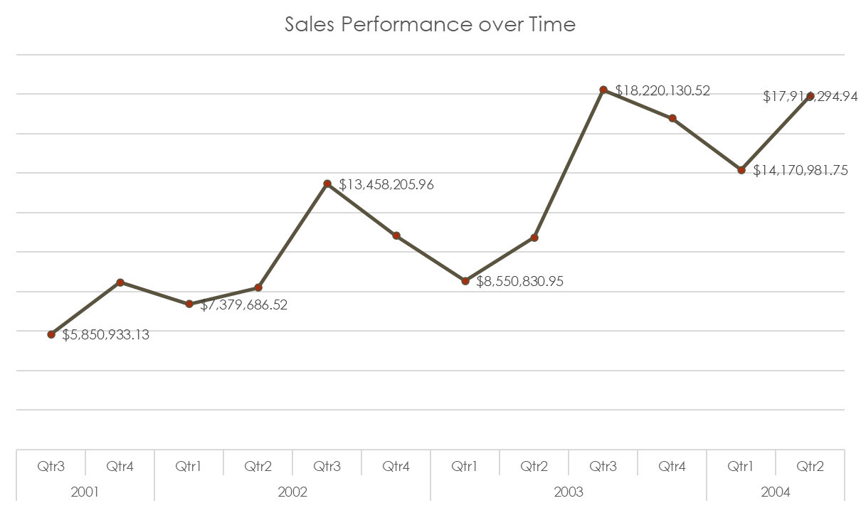
Sales Over Time
Key Insights
Sales performance from 2001 to 2004 showed a clear seasonal trend, with lower sales consistently occurring in the first quarter each year. In contrast, the third quarter consistently recorded the highest sales, indicating a strong seasonal demand during that period.

Slide 13
Key Insights
Top-Performing Region: The United States leads in offline sales with $72 million, highlighting its strong offline market.
Dominant Product Category: Bikes are the best-performing product both online (79% of sales) and offline (82% of sales), emphasizing their significant contribution.
Sales Leadership: Linda stands out as the top sales performer, driving a large portion of sales revenue.
Online Sales Success: The U.S. also leads in online sales, achieving $10 million, with Bikes being the most sold product category.

Slide 14
Recommendations
Invest in the U.S. Market: Allocate more resources to further strengthen the U.S. market, focusing on both online and offline sales channels.
Enhance Bike Promotions: Leverage the popularity of Bikes through targeted marketing and promotions, both online and offline.
Recognize and Incentivize Top Salespeople: Reward high performers like Linda to motivate and boost overall sales performance.
Optimize Online Strategies: Expand online marketing efforts for Bikes to maximize their already dominant position.

Slide 15
Thank you!

